Slide 1



Bute-Plus: A Bottom-Up Exact Solver for Treedepth
James Trimble
Notes:
Thank PACE committee and optil.io team for their work in organising and running the challenge.

Slide 2
The Treedepth Problem
A treedepth decomposition of connected graph G is a rooted tree with vertex set V(G), such that for each edge (v,w) in G, v is an ancestor of w or vice versa.
1
2
1
3
5
3
2
4
4
5
The treedepth of G is the smallest depth of any treedepth decomposition of G.
Notes:
To briefly recap, a TD decomposition of a given connected graph is a rooted tree on the vertex set of G, such that for any edge in G, the the endpoints of the edge have an ancestor-descendant relationship in the tree.
The tree depth of a graph is the minimum depth of a treedepth decomposition.

Slide 3
Elimination trees
A treedepth decomposition with the following property is called an elimination tree
For every subtree T’ of T, G[V(T’)] is connected
8
1
1
7
9
7
4
7
4
1
2
5
2
8
8
5
6
5
3
9
6
3
9
6
4
2
3
Notes:
An important concept for the Bute algorithm is an elimination tree. I’ll give a slightly unusual definition for this, which is equivalent to the standard definitions. An elimination tree is a TDD with the following property. For every subtree of the decomposition, the subgraph of the input graph induced by the subtree’s vertex set is connected.
Give examples.
Elimination trees have the useful property that there always exists an elimination tree whose depth equals the tree depth of the graph. So the Bute algorithm searches for an elimination tree rather than a general tree depth decomposition. This avoids having to deal with disconnected subgraphs.

Slide 4
Context
Bannach, M. and Berndt, S., Positive-Instance Driven Dynamic Programming for Graph Searching. WADS 2019
Hisao Tamaki: PID solvers for treewidth at PACE 2016 and PACE 2017
Ganian, R., et al. SAT-encodings for treecut width and treedepth. ALENEX 2019
SEA 2020 paper
Notes:
The Bute algorithm that I will describe in this talk is a bottom-up, positive instance driven dynamic programming algorithm. At its heart, it is similar to the algorithm for tree depth in Bannach and Berndt’s WADS 2019 paper. In turn, that paper generalises work by Tamaki on PID algorithms for treewidth, which he successfully entered in PACE 2016 and PACE 2017.
Finally, Ganian and coauthors introduced a SAT encoding for treedepth. While this is not competitive with the PACE Challenge solvers, it introduced a number of useful kernelisation and domination rules. My algorithm uses a version of the domination rule, but does not perform kernelisation.
To avoid any confusion, I will briefly mention that I presented an earlier algorithm for tree depth at SEA 2020. This is very different from the Bute algorithm, and is quite a lot slower than the leading PACE Challenge entries.

Slide 5
Running example
8
1
7
9
1
7
4
2
8
5
2
6
5
3
9
6
3
4
Find an elimination tree of depth at most 4
Notes:
The Bute solver solves the optimisation problem as a sequence of decision problems. It looks for an elimination tree of depth 1, then depth 2 and so on until it is successful. I’ll use the graph shown as a running example in this talk, with the goal of finding an elimination tree of depth 4. …

Slide 6
A sketch of the algorithm
8
1
7
9
1
7
4
2
8
5
2
6
5
3
9
6
3
4

Slide 7
A sketch of the algorithm
Step 1:
{9}, {6}, {3}, …
8
1
7
9
1
7
4
2
8
5
2
6
5
3
9
6
3
4
Notes:
I’ll begin by briefly sketching the Bute algorithm. Very informally, it begins by finding vertices that look like they could be leaf nodes of some elimination tree of appropriately low depth. In our example, the collection generated at this step will at least include vertices 9, 6, and 3 since, as you can see here, they _are_ leaf nodes of an elimination tree.

Slide 8
A sketch of the algorithm
Step 1:
{9}, {6}, {3}, …
8
1
7
9
Step 2:
{8,9}, {5,6}, {2,3}, …
1
7
4
2
8
5
2
6
5
3
9
6
3
4
Notes:
The second step is to find sets of vertices corresponding to subtrees rooted one level from the bottom of an elimination tree. The collection generated at this step will clearly contain the three sets shown. And this collection is created by joining together some elements of the first collection; I’ll talk more about this joining operation later.

Slide 9
A sketch of the algorithm
Step 1:
{9}, {6}, {3}, …
8
1
7
9
Step 2:
{8,9}, {5,6}, {2,3}, …
1
7
4
2
8
5
2
6
5
3
9
6
3
Step 3:
{7,8,9}, {2,3,4,5,6}, …
4
Notes:
Next, we go one level higher, and find all sets of vertices that could be the vertex set of a subtree rooted at depth 2 of an elimination tree.

Slide 10
A sketch of the algorithm
Step 1:
{9}, {6}, {3}, …
8
1
7
9
Step 2:
{8,9}, {5,6}, {2,3}, …
1
7
4
2
8
5
2
6
5
3
9
6
3
Step 3:
{7,8,9}, {2,3,4,5,6}, …
4
Step 4:
{1,2,3,4,5,6,7,8,9}
Notes:
Finally, we repeat this process at at depth 1. I’m omitting lots of details for now, but this step shows whether or not an elimination tree of the required depth exists.

Slide 11
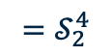
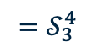
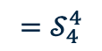
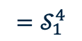
A sketch of the algorithm
Step 1:
{9}, {6}, {3}, …
$${=𝒮}_{4}^{4}$$
8
1
7
9
Step 2:
{8,9}, {5,6}, {2,3}, …
7
4
$${=𝒮}_{3}^{4}$$
1
2
8
5
2
6
5
3
9
6
3
Step 3:
{7,8,9}, {2,3,4,5,6}, …
4
$${=𝒮}_{2}^{4}$$
Step 4:
{1,2,3,4,5,6,7,8,9}
$${=𝒮}_{1}^{4}$$
Notes:
We call these collections generated by the algorithm S_4^4 to S_1^4, where the subscript corresponds to the depth at which the subtree is rooted and the superscript says that our target depth is 4.

Slide 12
The algorithm
$𝒮_{i}^{k}$: the collection of subsets S of V(G) satisfying:
G[S] is connected
G[S] admits an elimination tree of depth at most k – i + 1
S has fewer than i neighbours in G
$𝒮_{i}^{k}$ contains the vertex set of every subtree rooted at depth i of some elimination tree of depth at most k.
The algorithm: find $𝒮_{k}^{k}$, …, $𝒮_{1}^{k}$
Notes:
Now I’ll give a more precise definition of these collections of sets. S_i^k contains all subsets S of the vertex set of G satisfying the following three conditions.
First, the subgraph of G induced by S is connected (since this is required by the definition of an elimination tree)
Second, that induced subgraph has small tree depth.
Third, S has few neighbours in G, since these must be ancestors of the corresponding subtree in the overall elimination tree.
These three conditions are all necessary conditions for a set to be the vertex set of a subtree rooted at the corresponding depth. In the case of depth 1, they are also sufficient conditions.
So, in a nutshell, the algorithm for the decision problem is to create S_4^4, then S_3^4, S_2^4 and finally S_1^4. If S_1^4 is empty, the instance is unsatisfiable. If it contains the vertex set of the graph, it is satisfiable. It is possible to the generate an elimination tree with a small amount of extra bookkeeping, which I won’t describe here.
I’ll now show these S collections in more detail for our example graph, and then in a few slides I will show how to use the elements of collection S_{I+1}^4 to generate the collection S_i^4.

Slide 13

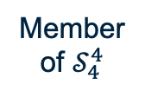
The algorithm
Member of $𝒮_{4}^{4}$
Induced subgraph
Elimination tree
8
8
7
9
{2}
7
9
1
2
2
1
6
5
3
2
4
6
5
8
3
{3}
7
9
4
1
2
3
6
5
3
4
8
{7}
7
9
$$𝒮_{4}^{4}$$
1
2
7
6
5
3
G[S] is connected
G[S] admits an ET of depth at most 1
S has < 4 neighbours in G
4
+ 5 more (all singletons except {1})

Slide 14

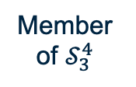
The algorithm
Member of $𝒮_{3}^{4}$
Induced subgraph
Elimination tree
8
8
7
9
{2}
7
9
1
2
2
1
6
5
3
2
4
6
5
8
3
{2,3}
7
9
2
4
1
2
6
5
3
4
3
8
{5,6}
7
9
5
$$𝒮_{3}^{4}$$
1
2
6
5
6
G[S] is connected
G[S] admits an ET of depth at most 2
S has < 3 neighbours in G
4
3
8
{4,5,6}
7
9
5
1
2
6
5
4
6
4
3
+ 8 more

Slide 15

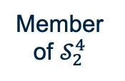
The algorithm
Member of $𝒮_{2}^{4}$
Induced subgraph
Elimination tree
8
7
9
{6}
8
7
9
1
1
2
6
2
6
5
3
6
5
4
3
8
7
4
7
9
{7,8,9}
1
2
8
6
5
3
4
9
$$𝒮_{2}^{4}$$
8
4
G[S] is connected
G[S] admits an ET of depth at most 3
S has < 2 neighbours in G
{2,3,4,5,6}
7
9
2
1
2
5
6
5
3
6
3
4

Slide 16

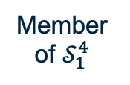
The algorithm
Member of $𝒮_{1}^{4}$
Induced subgraph
Elimination tree
8
7
9
1
1
2
{1,2,3,4,5,6,7,8,9}
8
7
9
7
4
6
5
1
2
3
6
5
8
5
2
4
4
3
9
6
3
$$𝒮_{1}^{4}$$
G[S] is connected
G[S] admits an ET of depth at most 4
S has no neighbours in G

Slide 17
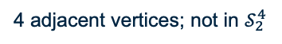
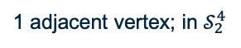
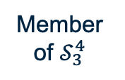
Combining subtrees
Member of $𝒮_{3}^{4}$
Induced subgraph
Elimination tree
4
8
7
9
5
2
{2}
1
2
5
2
6
3
6
3
4
1 adjacent vertex; in $𝒮_{2}^{4}$
8
{2,3}
7
9
2
1
2
6
5
3
4
3
8
1
{5,6}
7
9
5
5
2
1
2
6
5
6
4
3
6
3
8
4 adjacent vertices; not in $𝒮_{2}^{4}$
{4,5,6}
7
9
5
1
2
6
5
4
6
4
3
+ 8 more
Notes:
To show how one S_i^k collection is generated from the previous one, I will give an example of generating an element of S_2^4. This slide shows the elements of S_3^4. The idea is that we find a subset of this collection that could correspond to sibling subtrees of an elimination tree. The sets must be disjoint and not joined by any edge in the input graph. They also must have at least one neighbour in common, but the union of their neighbourhoods must be small.
In this example, the two highlighted sets - {2,3} and {5,6}, satisfy these properties. We then try the possible roots for the subtree. First we’ll try 1. This leads to a set which has only one neighbour in graph G, so it satisfies all the conditions for membership of S_2^4. If we try 4 as the root, on the other hand, it creates a set with too many neighbours, so it is not added to S_2^4.

Slide 18
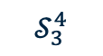
Trie data structure
$$𝒮_{3}^{4}$$
S | N(S)
{2} | {1,3}
{3} | {2,4}
{4} | {3,5}
{6} | {5}
{2,3} | {1,4}
{3,4} | {2,5}
{5,6} | {1,4}
{7,8} | {1,9}
{7,9} | {1,8}
{8,9} | {1,7}
{2,3,4} | {1,5}
{4,5,6} | {1,3}
8
7
9
1
2
6
5
3
4
N(S): {}
N(S): {1}
N(S): {2}
N(S): {3}
N(S): {5}
S: {6}
N(S): {1,3}
S: {2}
S: {4,5,6}
N(S): {1,4}
S: {2,3}
S: {5,6}
N(S): {1,5}
S: {2,3,4}
N(S): {1,7}
S: {8,9}
N(S): {1,8}
S: {7,9}
N(S): {1,9}
S: {7,8}
N(S): {2,4}
S: {3}
N(S): {2,5}
S: {3,4}
N(S): {3,5}
S: {4}
Notes:
Let’s go back to the collection S_3^4. The first column of the table shows the elements of this collection, and the second column shows their neighbourhoods. When try to combine these sets, an obvious first step would be to choose one of the sets, and test each of the other sets for compatibility. But the S collections for some of the PACE Challenge instances have over a million elements, so this simple approach becomes too slow.
Instead, the Bute algorithm stores the collection in a trie data structure, with the neighbourhood of each set sorted and viewed as a string of vertices. For example, the highlighted set in the table is shown highlighted here in the trie.
At this point in the algorithm, the only sets that are compatible with {3,4} are ones whose neighbourhood contains no vertices other than 3 or 4; otherwise the combined neighbourhood would be too large. So when we traverse the trie in search of compatible sets, we can backtrack at the red nodes.
I have also tried using this kind of trie in Tamaki’s PID algorithm for tree width, and it seems to give slight speed-ups at the expense of using more memory than Tamaki’s block sieve data structure.

Slide 19
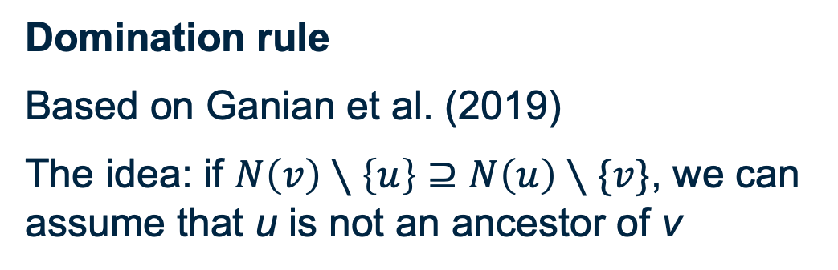
Other main features
Domination rule
Based on Ganian et al. (2019)
The idea: if $N\left(v\right)∖\left\{u\right\}⊇N\left(u\right)∖\{v\}$, we can assume that u is not an ancestor of v
Heuristic presolve
Uses Tweed-Plus (4th place in heuristic track)
Often avoids the need to solve the hardest decision problem

Slide 20
Implementations
C – submitted to PACE 2020
Use for easy instances
Bute: no heuristic presolve
Bute-Plus: heuristic presolve
Use to reproduce PACE results
Java – November / December 2020
https://github.com/jamestrimble/bute
Tidier code!

Slide 21
Possibilities for future work
Kernelisation rules (from other PACE solvers)
An algorithm portfolio (since no PACE entrant dominates)
Better heuristic presolve (from PACE heuristic track)

Slide 22

Thank you
James Trimble
j.trimble.1@research.gla.ac.uk

Slide 23
Elimination trees
The elimination tree of a single-vertex graph is a single-vertex tree
1
1
To form an elimination tree of a larger connected graph:
1. Remove a vertex; make this the root
2. Form an elimination tree of each remaining component
3. Make the root of each of these trees a child of the root
6
1
1
1
1
2
6
2
6
3
6
3
4
2
4
2
5
3
5
3
5
5
4
4

Slide 24
The Treedepth Problem: examples
1
1
2
2
1
2
3
3
1
2
3
4
5
5
5
3
4
4
4
5
1
2
8
3
8
4
7
4
4
1
2
3
4
5
6
7
2
6
6
5
2
6
1
3
5
7
1
3
5
7

